Slide 1
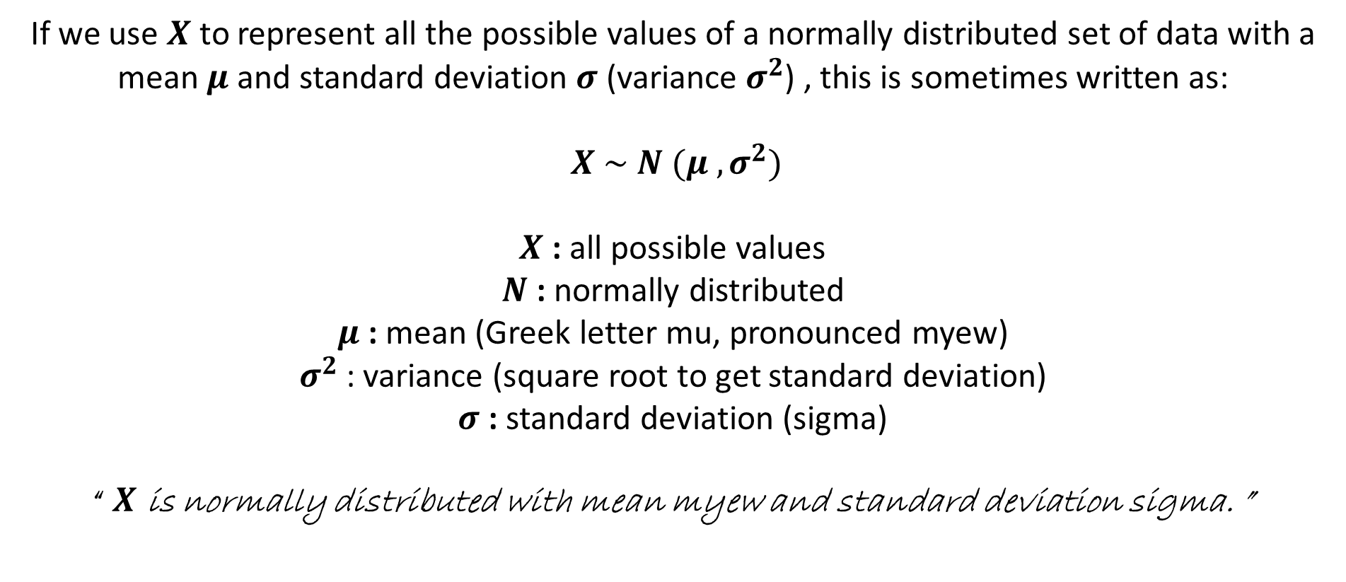
Normal Distribution Notation
If we use $X$to represent all the possible values of a normally distributed set of data with a mean $μ$ and standard deviation $σ$ (variance $σ^{2}$) , this is sometimes written as:
$X \sim N (μ , σ^{2})$
$X$ : all possible values
$N$ : normally distributed
$μ$ : mean (Greek letter mu, pronounced myew)
$σ^{2}$: variance (square root to get standard deviation)
$σ$ : standard deviation (sigma)
“ $X$ is normally distributed with mean myew and standard deviation sigma. ”

Slide 2
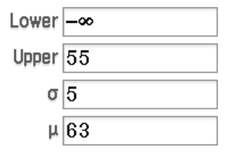
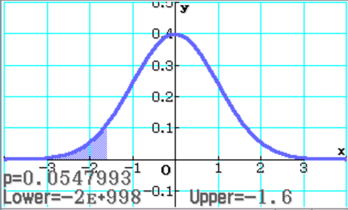
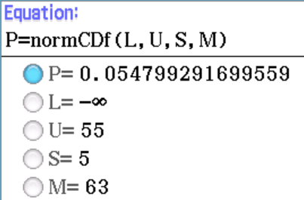

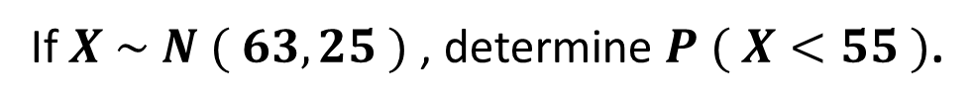
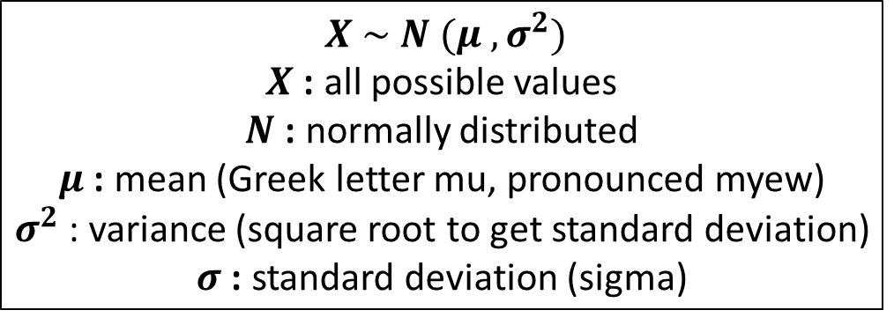
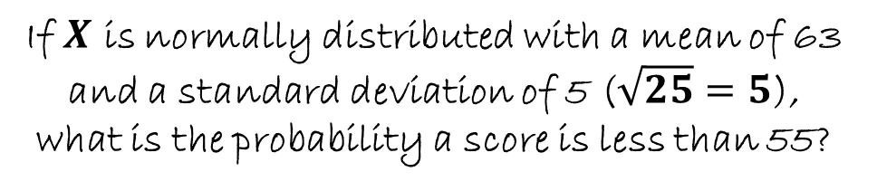
Example 4
$X \sim N (μ , σ^{2})$
$X$ : all possible values
$N$ : normally distributed
$μ$ : mean (Greek letter mu, pronounced myew)
$σ^{2}$: variance (square root to get standard deviation)
$σ$ : standard deviation (sigma)
If $X \sim N ( 63, 25 )$ , determine $P ( X<55 )$.
If $X$ is normally distributed with a mean of 63 and a standard deviation of 5 ($\sqrt{25}=5$), what is the probability a score is less than 55?
$$P \left( X <55 \right)=0.0548$$
Using Statistics (can show graph)
Using E-activity (no graph)

Slide 3
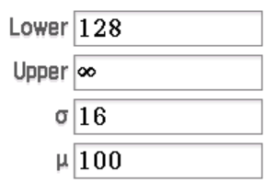
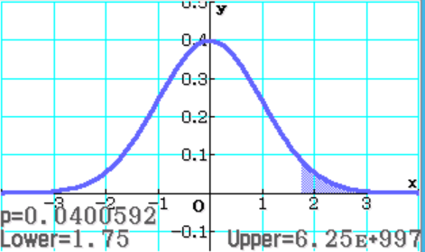


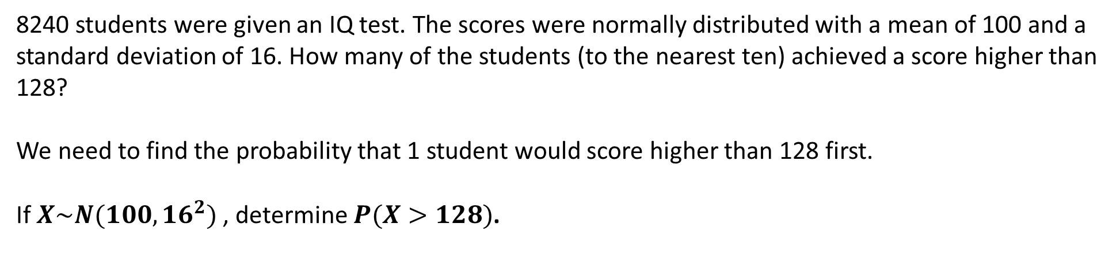

Example 5
8240 students were given an IQ test. The scores were normally distributed with a mean of 100 and a standard deviation of 16. How many of the students (to the nearest ten) achieved a score higher than 128?
We need to find the probability that 1 student would score higher than 128 first.
If $X\sim N(100, {16}^{2})$ , determine $P(X>128)$.
$$P\left(X>128\right)=0.0401$$
$$0.0401×8240=330.424$$
Approximately 330 students achieved a score in excess of 128.

Slide 4
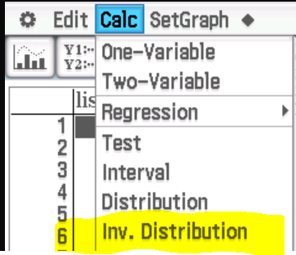
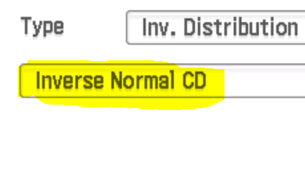
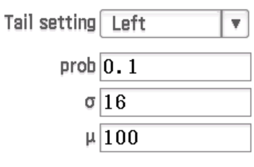
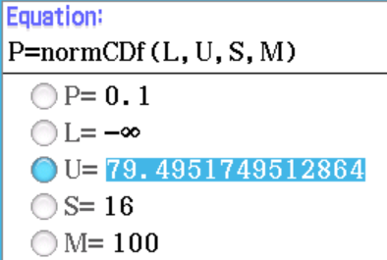

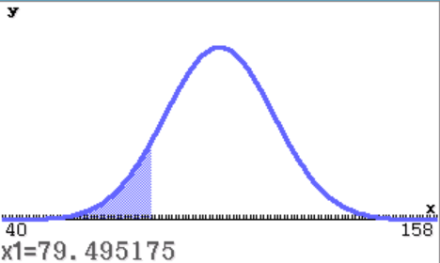
Example 5
8240 students were given an IQ test. The scores were normally distributed with a mean of 100 and a standard deviation of 16. What score were the bottom 10% of students below?
Here we know the probability is 0.1, and we also know that we are looking at the left hand side of the normal distribution graph (the bottom). We can use the inverse normal distribution function to help us solve this.
10% of the students received a score below 79.5.
Using E-activity
Using Statistics

Slide 5
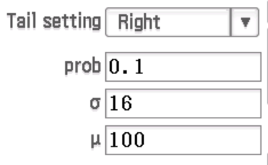
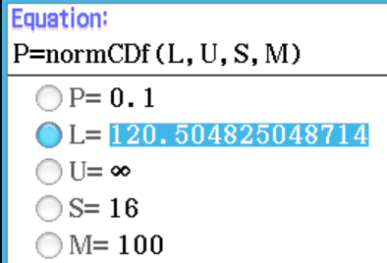

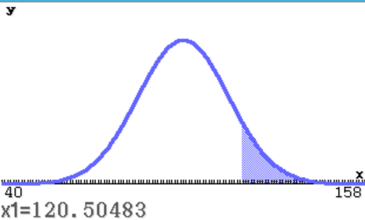
Example 5
8240 students were given an IQ test. The scores were normally distributed with a mean of 100 and a standard deviation of 16. What score were the top 10% of students above?
Here we know the probability is 0.1, and we also know that we are looking at the right hand side of the normal distribution graph (the top). We can use the inverse normal distribution function to help us solve this.
10% of the students received a score above 120.5.
Using E-activity
Using Statistics

Slide 6
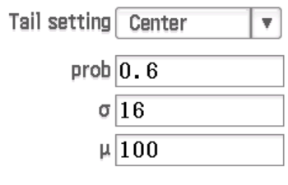

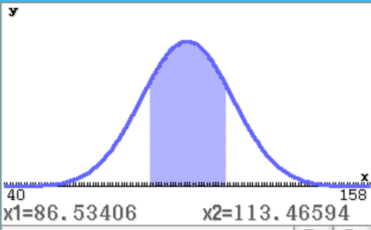
Example 5
8240 students were given an IQ test. The scores were normally distributed with a mean of 100 and a standard deviation of 16. What scores were the middle 60% of students between?
Here we know the probability is 0.6, and we also know that we are looking at the centre of the normal distribution graph (the middle). We can use the inverse normal distribution function to help us solve this.
60% of the students score between 86.5 and 113.5.
Using E-activity – not very easy as you are looking for two values and E-activity only lets you solve for one at a time!
Using Statistics

Slide 7
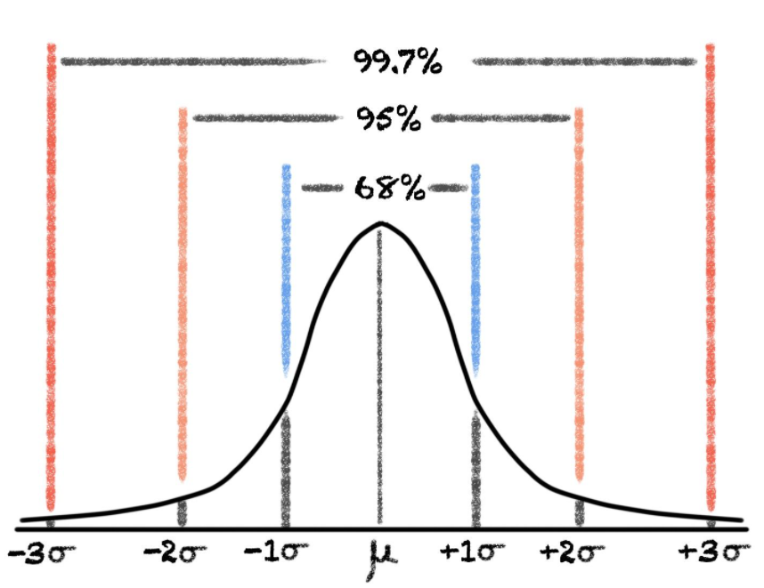
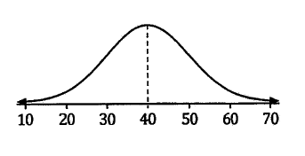
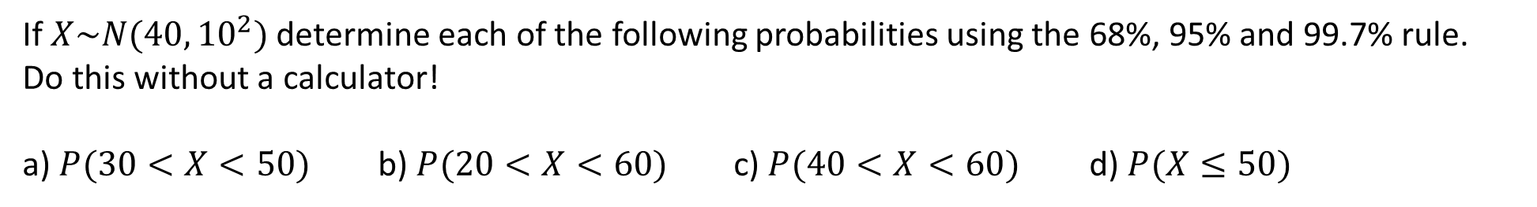
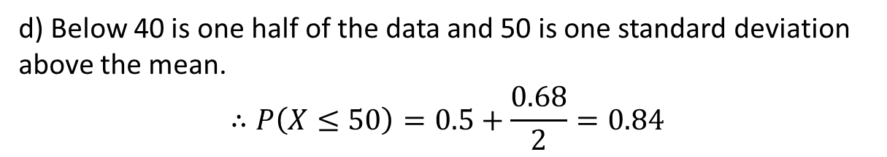
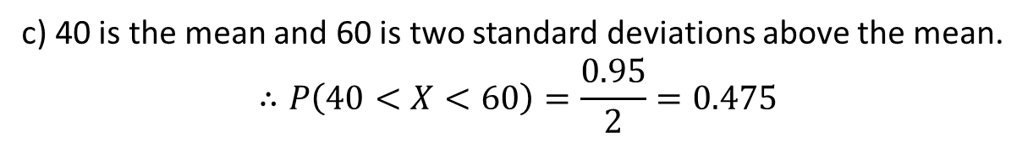
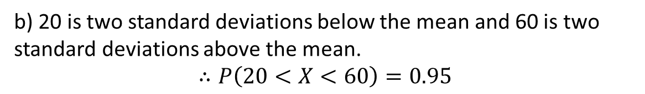
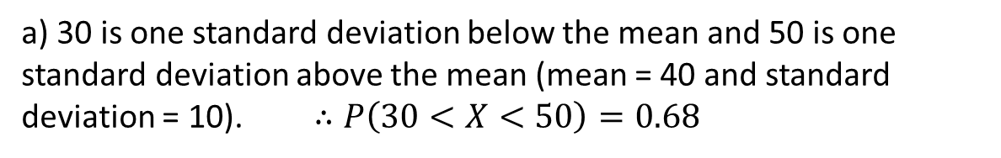
Example 6
If $X\sim N(40,{10}^{2})$ determine each of the following probabilities using the 68%, 95% and 99.7% rule.
Do this without a calculator!
a) $P(30<X<50)$ b) $P(20<X<60)$ c) $P(40<X<60)$ d) $P(X≤50)$
a) 30 is one standard deviation below the mean and 50 is one standard deviation above the mean (mean = 40 and standard deviation = 10). $∴P\left(30<X<50\right)=0.68$
b) 20 is two standard deviations below the mean and 60 is two standard deviations above the mean.
$$∴P\left(20<X<60\right)=0.95$$
c) 40 is the mean and 60 is two standard deviations above the mean.
$$∴P\left(40<X<60\right)=\frac{0.95}{2}=0.475$$
d) Below 40 is one half of the data and 50 is one standard deviation above the mean.
$$∴P\left(X≤50\right)=0.5+\frac{0.68}{2}=0.84$$

Slide 8
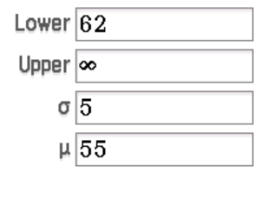
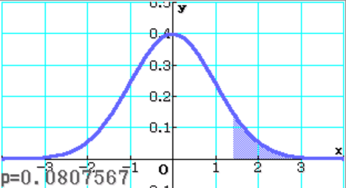


Example 7
The time it takes from Simon getting out of bed until his arrival at school is normally distributed with a mean of 55 minutes and a standard deviation of 5 minutes. If Simons arrives at school after 9:10am, he gets a detention for being late.
One day, Simon gets out of bed at 8:08am, what is the probability of him being late?
From 8:08am until 9:10am gives Simon 62 minutes to get to school before he is late.
If $X\sim N(55, 5^{2})$ , determine $P(X>62)$
If Simon gets out of bed at 8:08am, the probability of him being late is 0.0808, or 8.1%.

Slide 9
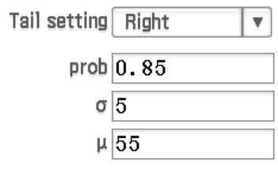
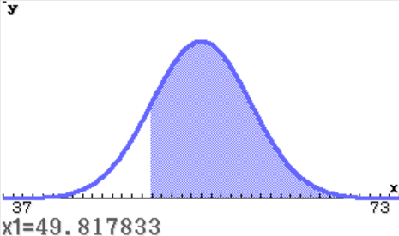

Example 7
The time it takes from Simon getting out of bed until his arrival at school is normally distributed with a mean of 55 minutes and a standard deviation of 5 minutes. If Simons arrives at school after 9:10am, he gets a detention for being late.
For a while, Simon gets out of bed at the same time each day but arrives late to school around 85% of the time. What time is he getting out of bed?
Here we know the probability is 0.85, and we also know that we are looking at the right hand side of the normal distribution graph. We can use the inverse normal distribution function to help us solve this.
If Simon is late around 85% of the time, he is giving himself about 50 minutes to get to school. This means he is getting out of bed at 8:20am.

Slide 10
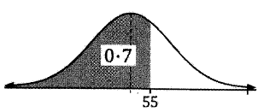
Quantiles
Quantiles are the values which a certain proportion of the normal
distribution falls below. For example, if 0.7 (70%) of the distribution
is below 55, that means 55 is the 0.7 quantile.
We can also refer to 55 as being the 70th percentile.
Quantiles are out of 1 and percentiles are out of 100.
We are already used to calling the 0.25 quantile (25th percentile) the lower quartile and the 0.75 quantile (75th percentile) the upper quartile (see Chapter 4 box and whisker plots).
Quartiles divide the distribution into 4 equal parts and percentiles divide the distribution into 100 equal parts.

Slide 11
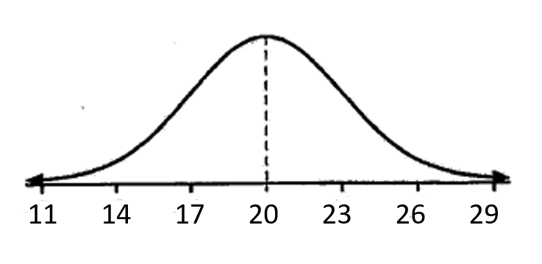
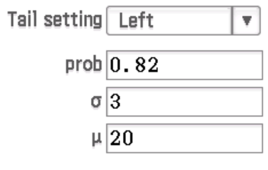

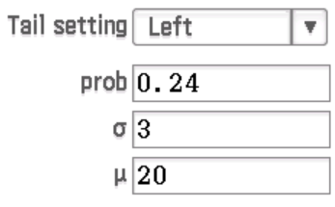

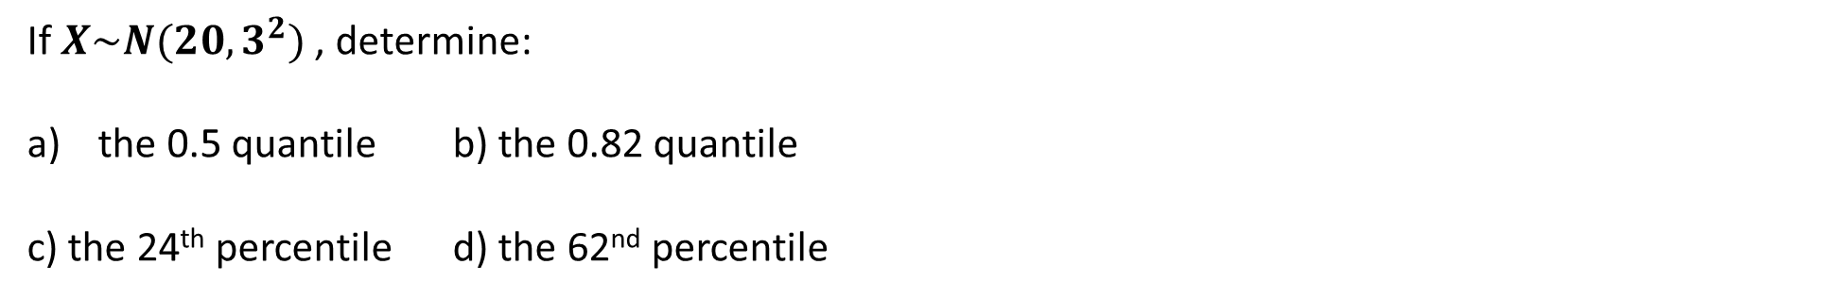
Example 8
Now do Exercise 13C
If $X\sim N(20,3^{2})$ , determine:
the 0.5 quantile b) the 0.82 quantile
c) the 24th percentile d) the 62nd percentile
a) Equivalent to half the data so the 0.5 quantile is 20 (the mean)
b) Using inverse distribution on Class Pad, the 0.82 quantile is 22.7
c) Using inverse distribution on Class Pad, the 24th percentile is 17.9
d) Using inverse distribution on Class Pad, the 62nd percentile is 20.9

